Slide 1
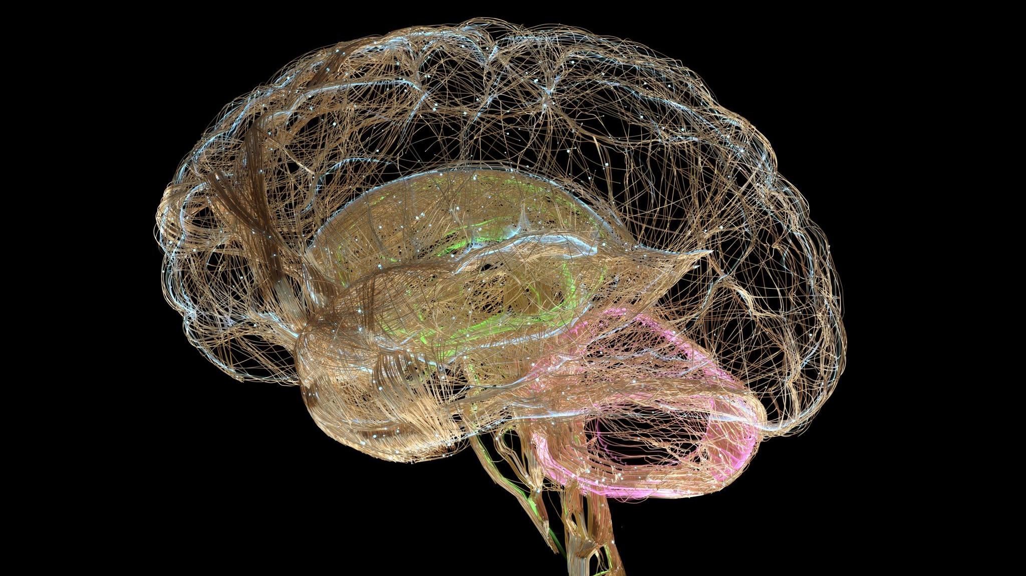
BRAIN TUMOR CLASSIFICATION DETECTION USING MRI IMAGES AND DEEP LEARNING
GULFAM MALIK 03-134202-017
AMEER HAMZA 03-134202-098

Slide 2
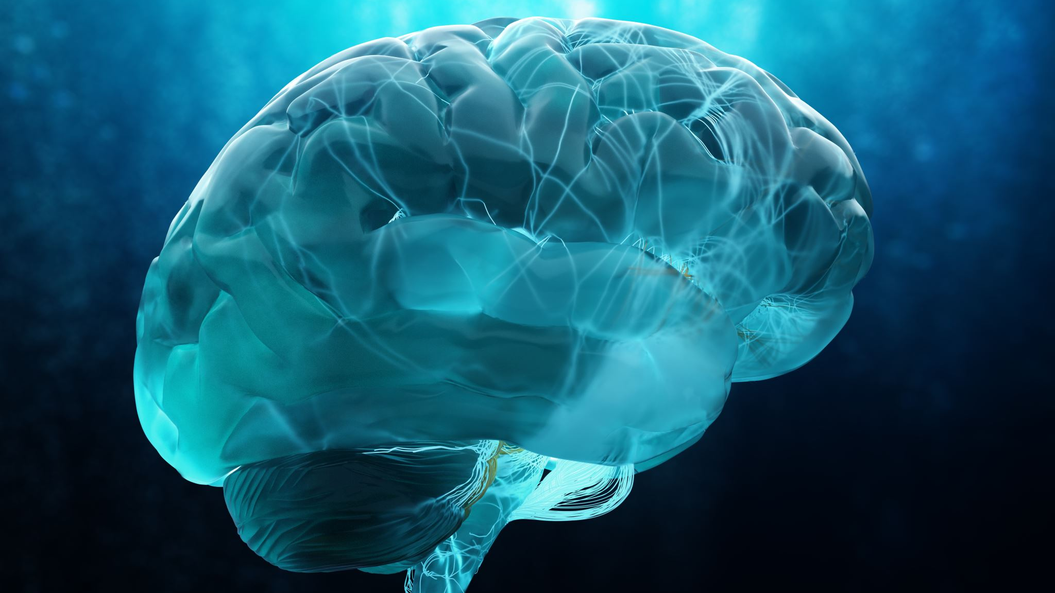
INTRODUCTION
BRAIN TUMOR CLASSIFICATION PLAYS A CRITICAL ROLE IN DIAGNOSING AND TREATING BRAIN-RELATED DISEASES. MANUAL IDENTIFICATION AND CLASSIFICATION OF BRAIN TUMORS FROM MRI (MAGNETIC RESONANCE IMAGING) IMAGES CAN BE TIME-CONSUMING AND PRONE TO HUMAN ERROR.
THIS PROJECT AIMS TO DEVELOP A DEEP LEARNING MODEL THAT CAN ACCURATELY CLASSIFY BRAIN TUMOR IMAGES INTO DIFFERENT CATEGORIES, NAMELY GLIOMA TUMOR, MENINGIOMA TUMOR, PITUITARY TUMOR, AND NO TUMOR.
THE MODEL LEVERAGES CONVOLUTIONAL NEURAL NETWORKS (CNNS), A POWERFUL DEEP LEARNING ARCHITECTURE THAT EXCELS AT IMAGE CLASSIFICATION TASKS.
THE DATASET USED IN THIS PROJECT CONSISTS OF BRAIN MRI IMAGES, WITH EACH IMAGE LABELED WITH THE CORRESPONDING TUMOR CATEGORY.
THE PROJECT INVOLVES PREPROCESSING THE DATA, BUILDING AND TRAINING THE CNN MODEL, AND EVALUATING ITS PERFORMANCE ON A SEPARATE TEST SET.

Slide 3
OBJECTIVE
Develop An Accurate Brain Tumor Classification Model
Improve Diagnostic Efficiency
Enhance Treatment Planning
Reduce Human Error And Subjectivity
Facilitate Research And Collaboration
Explore The Potential Of Deep Learning In Healthcare
By Setting These Objectives, Our Project Aims To Contribute To The Advancement Of Brain Tumor Classification, Enhance Medical Decision-making, And Explore The Broader Applications Of Deep Learning In Healthcare.

Slide 4
MOTIVATION:
THE MOTIVATION FOR THIS PROJECT IS TO IMPROVE THE DIAGNOSIS AND TREATMENT OF BRAIN TUMORS BY PROVIDING DOCTORS WITH A FAST AND ACCURATE WAY TO CLASSIFY AND SEGMENT TUMORS USING MRI IMAGES. THE DEVELOPMENT OF AN AUTOMATED BRAIN TUMOR CLASSIFICATION SYSTEM USING DEEP LEARNING TECHNIQUES OFFERS SEVERAL COMPELLING MOTIVATIONS:
IMPROVED DIAGNOSTIC ACCURACY
TIME-EFFICIENT DIAGNOSIS
SUPPORT FOR MEDICAL PROFESSIONALS
ADVANCEMENT IN NEUROIMAGING RESEARCH

Slide 5

DATASET
THE IMAGING MODALITY UTILIZED, SUCH AS MRI (MAGNETIC RESONANCE IMAGING)
Source of Data Set is Kaggle platform.
Total Images are Almost 4k in the Data Set,
Data Set is Divided into two Folders Training and Testing.

Slide 6

MODEL ARCHITECTURE
convolutional neural network (CNN)
the convolutional layers, pooling layers, and fully connected layers used.

Slide 7
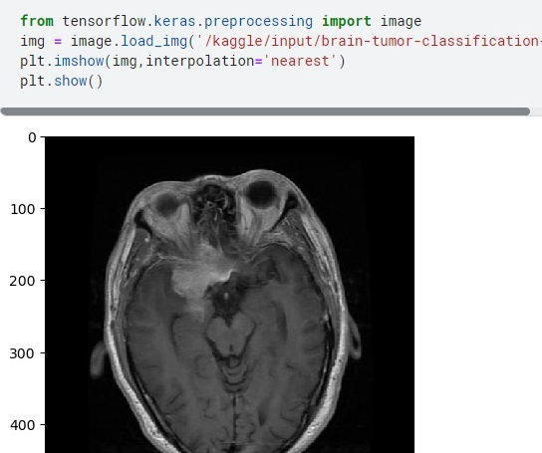
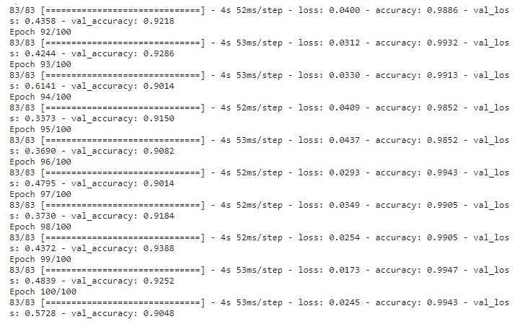
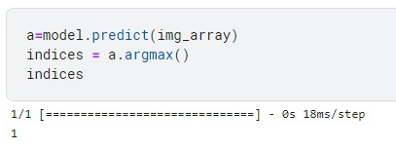
TRAINING AND EVALUATION

Slide 8
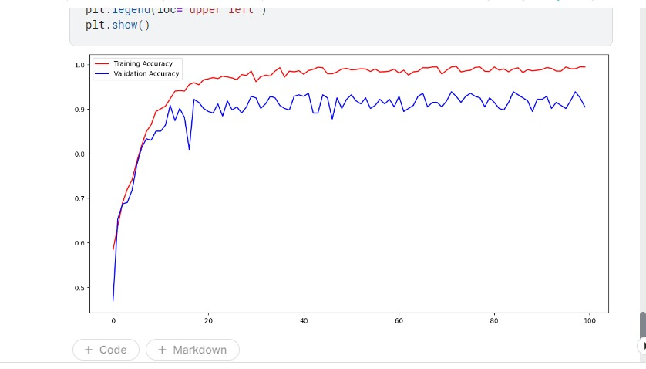
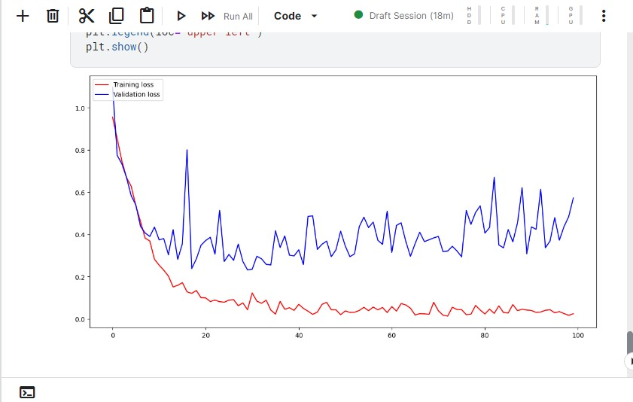
DISCUSSION
VALIDATION ACCURACY UP TO 88%.
GIVE RESULT UP TO 4 TYPES
GLIOMA_TUMOR AS 0
MENINGIOMA_TUMOR AS 1
NO_TUMOR AS 2
PITUITARY_TUMOR AS 3

Slide 9
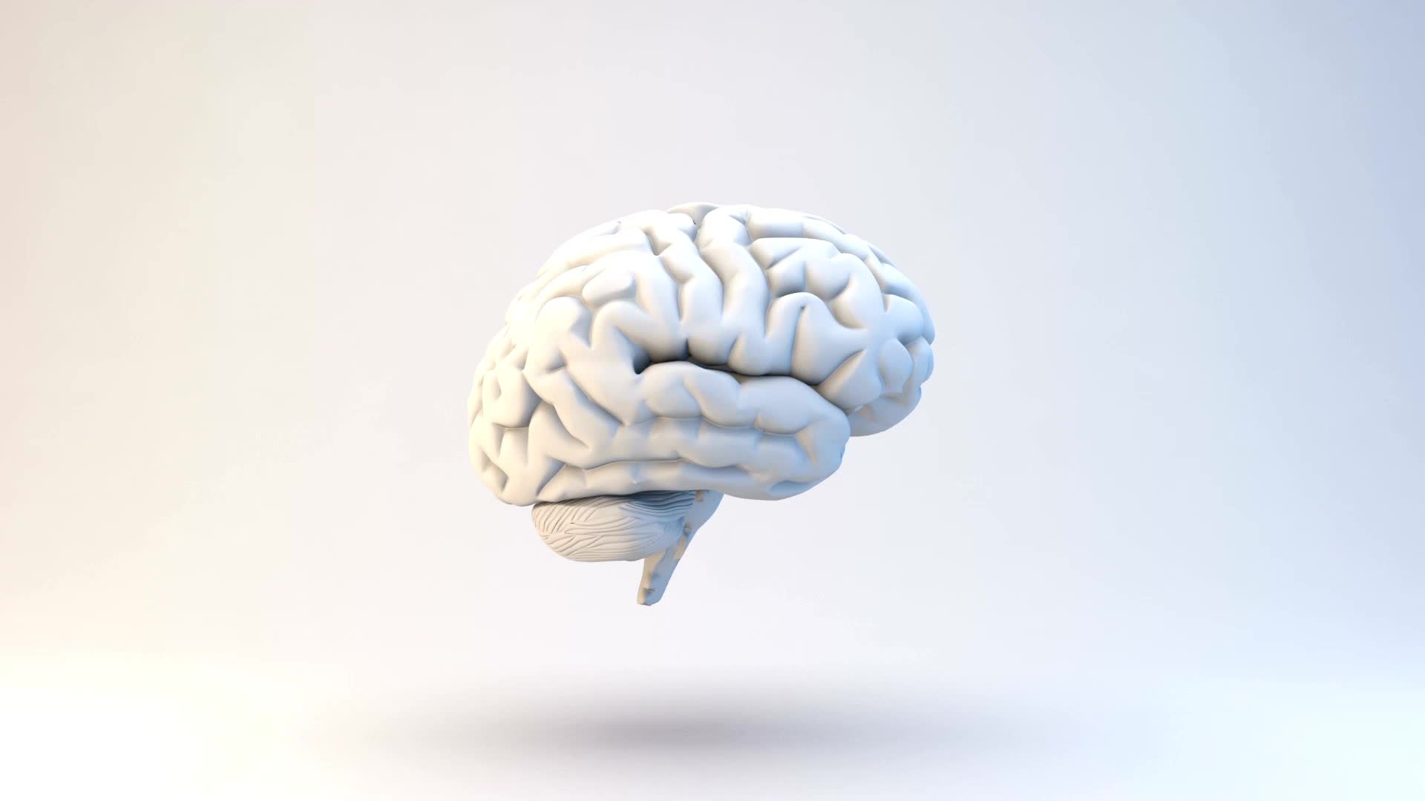
CONCLUSION
OVERALL, OUR BRAIN TUMOR CLASSIFICATION PROJECT DEMONSTRATES THE POWER OF MACHINE LEARNING AND DEEP LEARNING IN REVOLUTIONIZING MEDICAL DIAGNOSTICS. IT SERVES AS A STEPPING STONE TOWARDS FURTHER ADVANCEMENTS IN AUTOMATED MEDICAL IMAGE ANALYSIS, PAVING THE WAY FOR IMPROVED HEALTHCARE PRACTICES AND ENHANCING THE CAPABILITIES OF HEALTHCARE PROFESSIONALS IN DIAGNOSING AND TREATING BRAIN TUMORS.

Slide 10
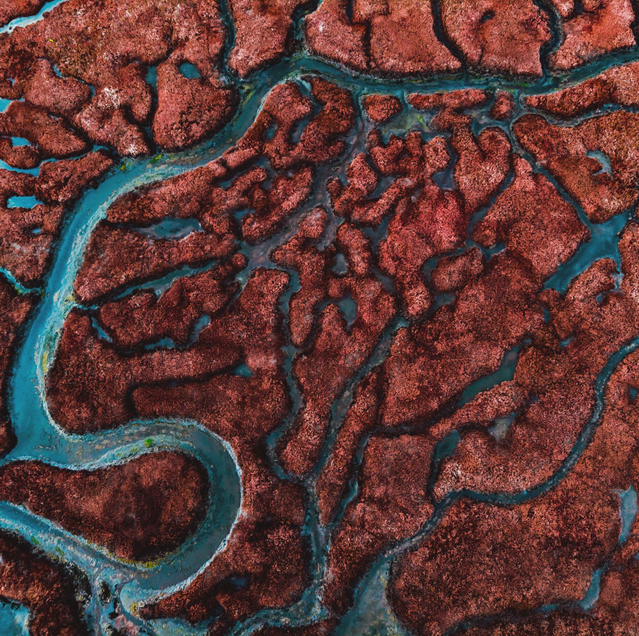
REFERENCES
HTTPS://WWW.KAGGLE.COM/DATASETS/SARTAJBHUVAJI/BRAIN-TUMOR-CLASSIFICATION-MRI

